Slide 1


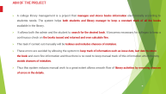
LIBRARY MANAGEMENT SYSTEM
Team number:3024
Team Members:
2200032335 G. Sai Balaji
2200032335 P.srinidh
2200032343 D.Harshith

Slide 2
AIM OF THE PROJECT
A college library management is a project that manages and stores books information electronically according to students needs. The system helps both students and library manager to keep a constant track of all the books available in the library.
It allows both the admin and the student to search for the desired book. It becomes necessary for colleges to keep a continuous check on the books issued and returned and even calculate fine.
This task if carried out manually will be tedious and includes chances of mistakes.
These errors are avoided by allowing the system to keep track of information such as issue date, last date to return the book and even fine information and thus there is no need to keep manual track of this information which thereby avoids chances of mistakes.
Thus this system reduces manual work to a great extent allows smooth flow of library activities by removing chances of errors in the details.

Slide 3
PROPOSED SYSTEM
Proposed system is an automated Library Management System. Through our software user can add books, search books, renewal, update information, edit information, and return books in quick time. Our proposed system has the following advantages.
Developed a well-organized book issue and searching system. Produced a well-designed and functioning system in accordance to the needs and wants of the borrowers.
Minimized the task and the effort being performed by both the owners and borrowers.
Provided the school and the students a well-organize and well-presented reports.
. User friendly interface
. Fast access to database
. Less error
. More Storage Capacity
. Search facility
. Look and Feel Environment
. Quick transaction

Slide 4
OBJECTIVE OF THIS PROJECT
This project system was highly recommended due to the rapid increase of computer related tools in the industry.
With this proposed system features and functions of the online book shop and the e-library that will be able to accommodate more reliably consistent and faster in providing a better service to the users.

Slide 5

SOFTWARE AND HARDWARE REQUIREMENTS
HARDWARE REQUIREMENTS:
Processor : intel i3
Ram : 4GB
Hard disk : 512GB
SOFTWARE REQUIREMENTS:
Front end : java script, materiel ui
Back end : Mongodb, mysql

Slide 6
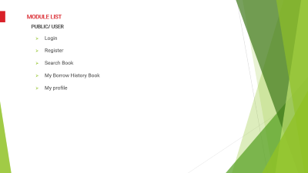
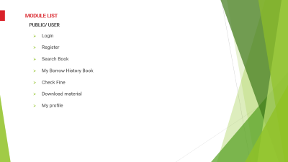
ADVANTAGES OF LIBRARY MANAGEMENT SYSTEM
Efficient resource management
Easy access to information
Improved data management
Enhanced user experience
Remote access
Customization and scalability

Slide 7

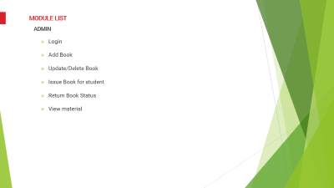
MODULE LIST
PUBLIC/ USER
Login
Register
Search Book
My Borrow History Book
My profile

Slide 8
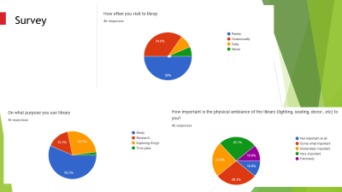
MODULE LIST
ADMIN
Login
Add Book
Update/Delete Book
View material

Slide 9
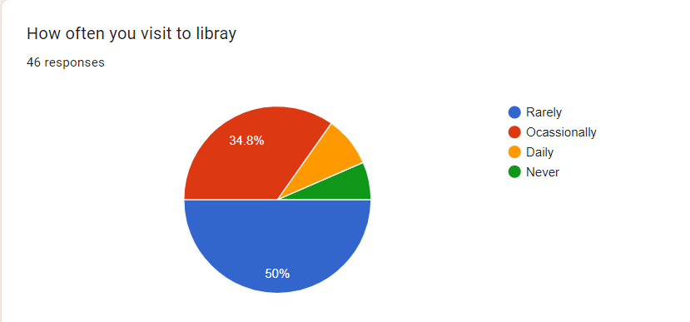
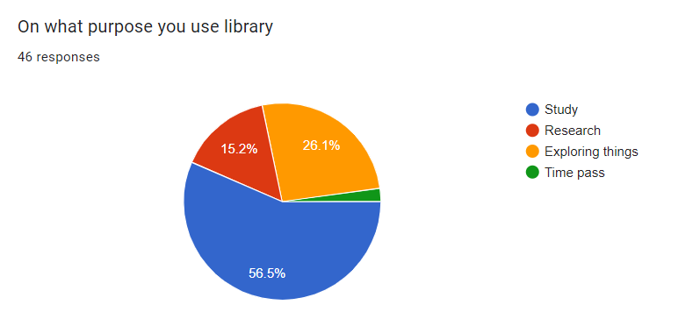
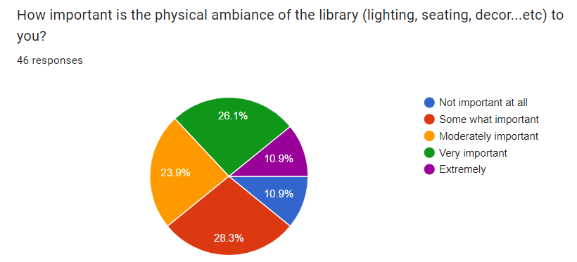
Survey

Slide 10
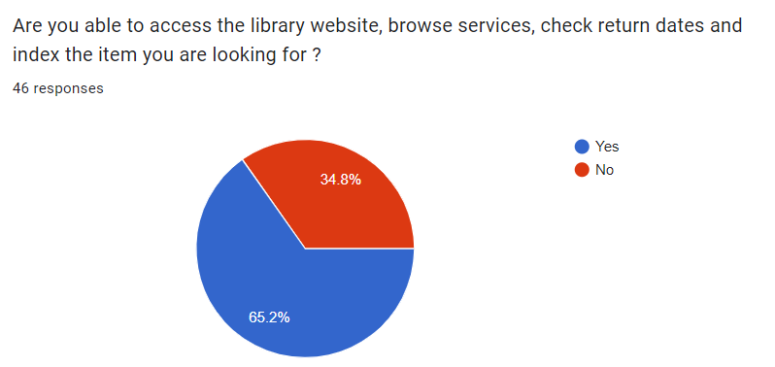
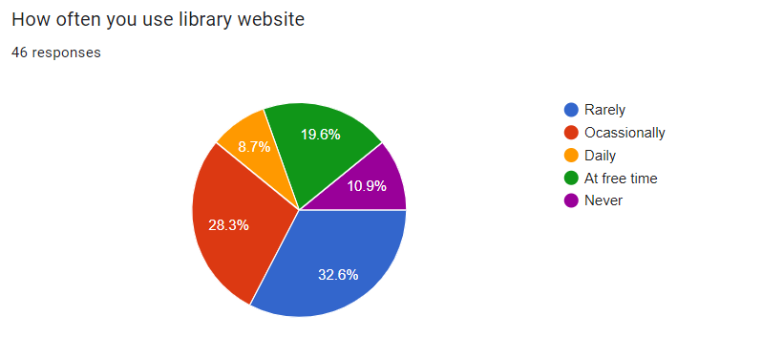

Slide 11
CONCLUSION
Hence we have designed the project to provide the user with easy navigation, retrieval of data and necessary feedback as much as possible.
In this project, the user is provided with an online system that can be used to issue and return books in library management online. It should be convenient for the student to view the contents of their status and to be able to return or add books to their account.
The Online library System provides a number of features that are designed to make the student more comfortable.
This project helps in understanding the creation of an interaction and the transparency between the student and the librarian of the books through the system.

Slide 12

Initial login page

Slide 13
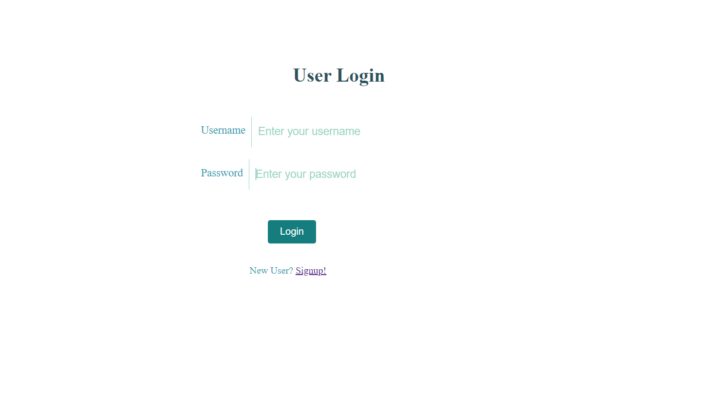
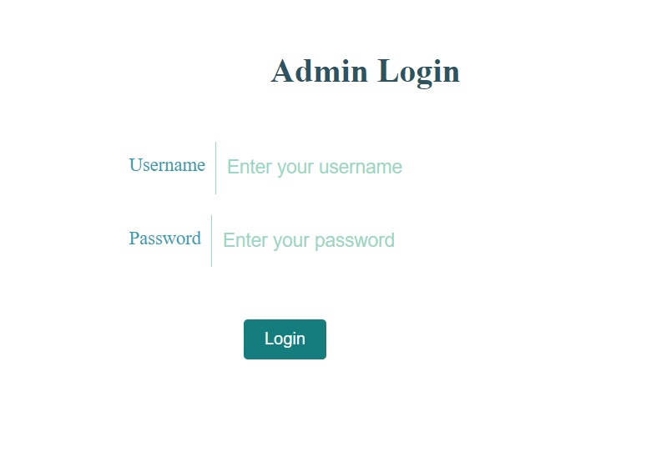
Login pages

Slide 14
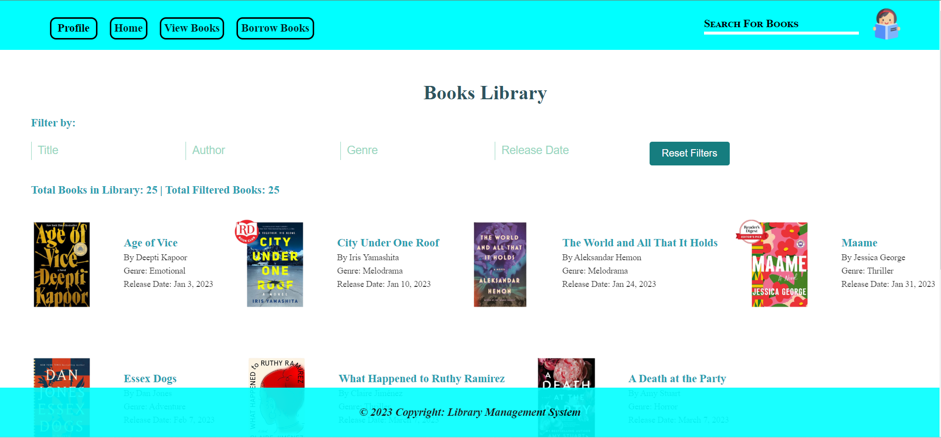
View books

Slide 15
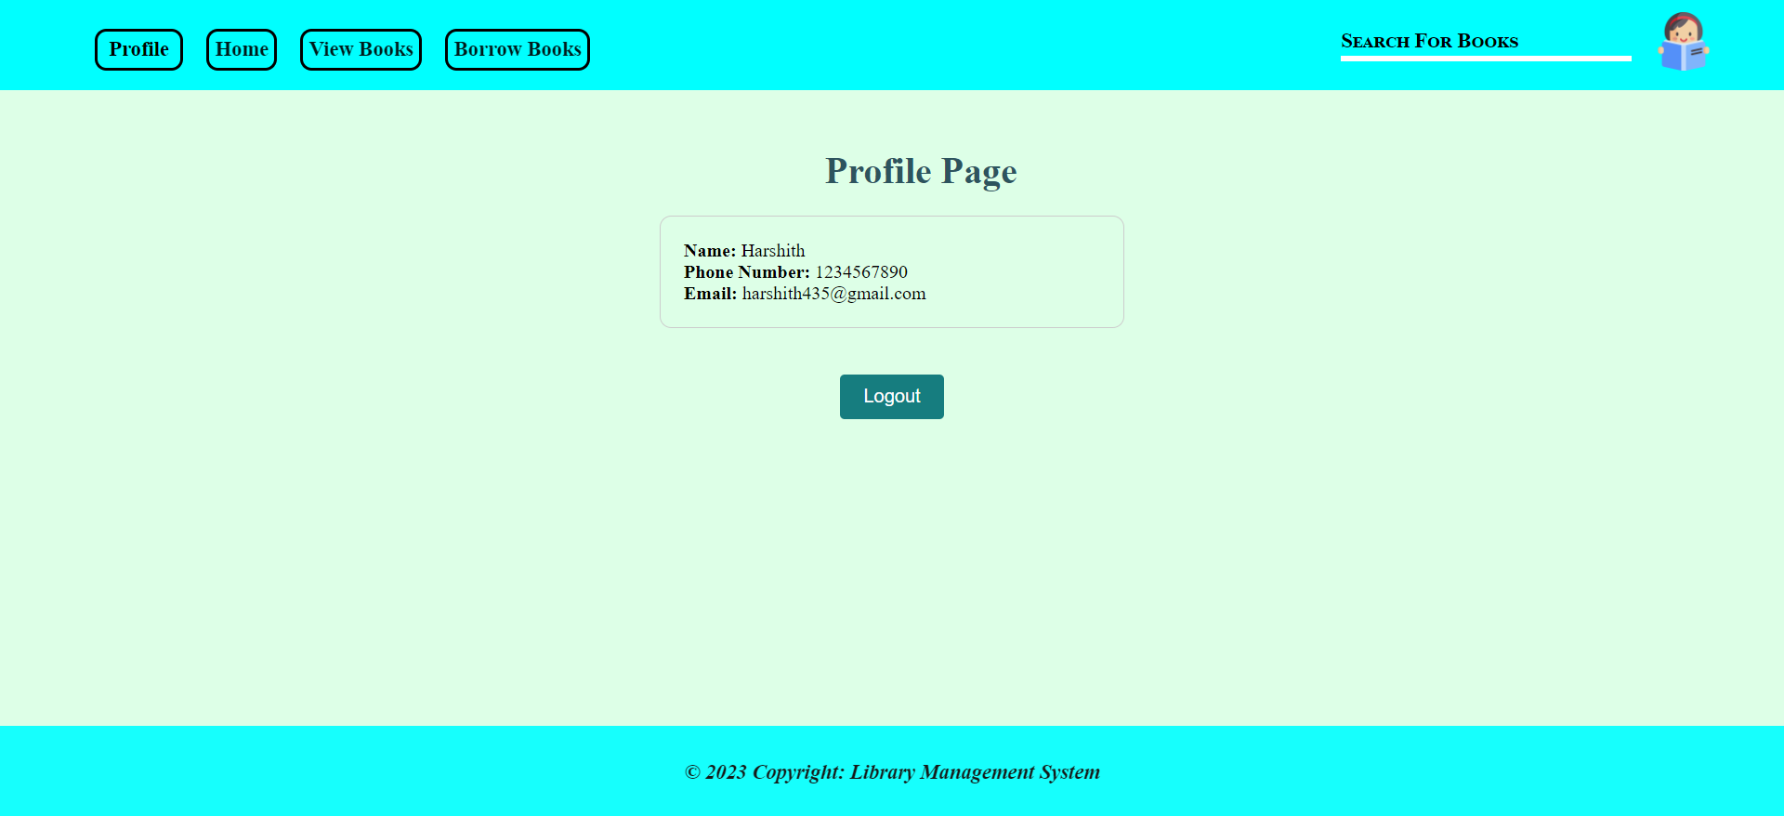
User profile

Slide 16
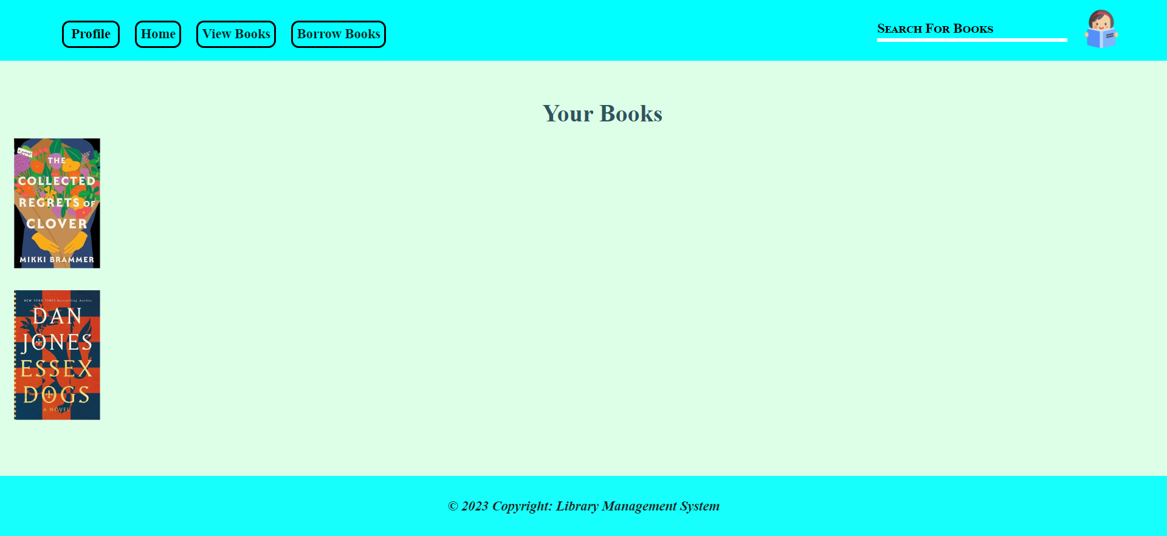
Borrow books

Slide 17
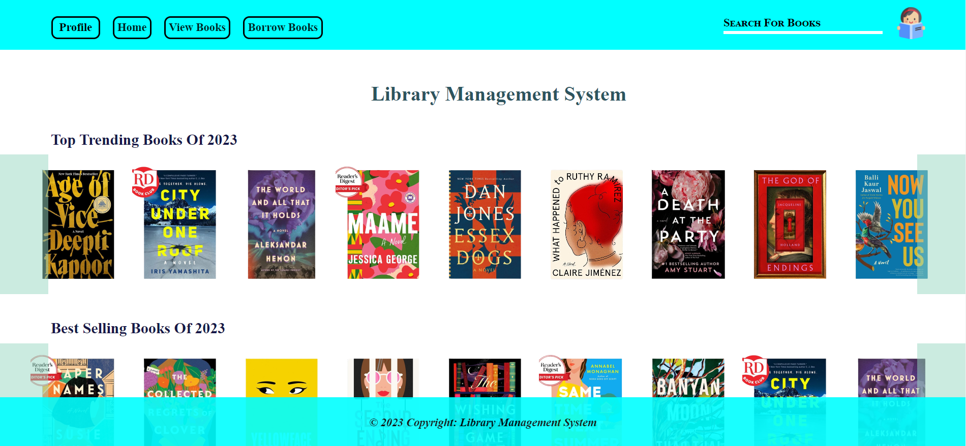
home

Slide 18
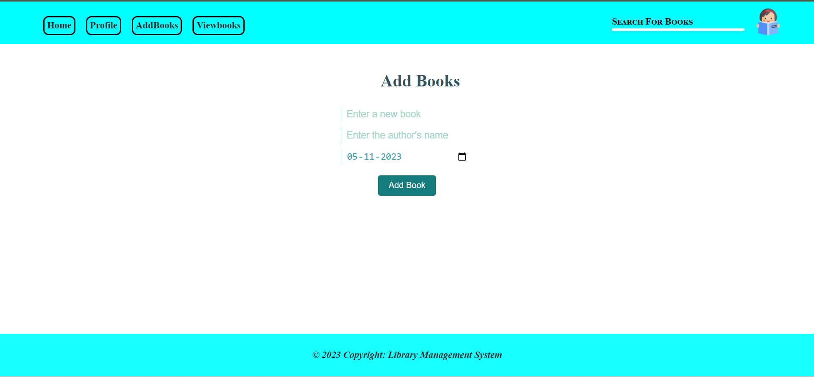
Add Books

Slide 19
THANK YOU

